Slide 1

NBA Centers
By Carlin Celius

Slide 2
Kareem Abdul-Jabbar is an American former professional basketball player who played 20 seasons in the National Basketball Association for the Milwaukee Bucks and the Los Angeles Lakers.
Yao Ming is a Chinese basketball executive and former professional player. He played for the Shanghai Sharks of the Chinese Basketball Association and the Houston Rockets of the National Basketball Association.
Shaquille Rashaun O'Neal, known commonly as "Shaq", is an American former professional basketball player who is a sports analyst on the television program Inside the NBA. O'Neal is regarded as one of the greatest basketball players and centers of all time. After playing college basketball for the LSU Tigers, O'Neal was drafted by the Orlando Magic with the first overall pick in the 1992 NBA draft. He quickly became one of the best centers in the league, winning Rookie of the Year in 1992–93 and leading his team to the 1995 NBA Finals. After four years with the Magic, O'Neal signed as a free agent with the Los Angeles Lakers. They won three consecutive championships in 2000, 2001, and 2002. Amid tension between O'Neal and Kobe Bryant, O'Neal was traded to the Miami Heat in 2004, and his fourth NBA championship followed in 2006.

Slide 3

Flaws
In todays analysis we are going analayze eeach of three players and who was ,ore dominant with age , and point s with team percentage . But due to the data I was not able to present itself with only one player to point to the season

Slide 4
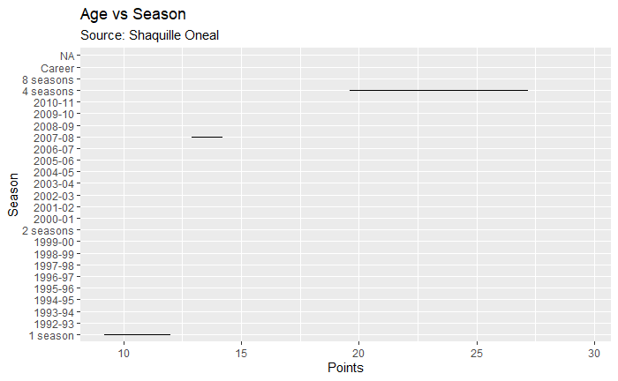
Out of all the season shaq played How many seasons and how many points was he more efficient for the team ?

Slide 5
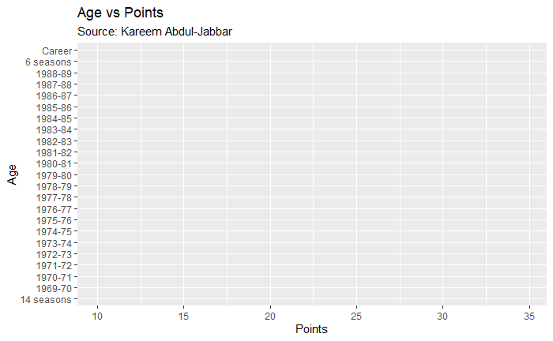
Out of all the season Kareem has played how many season and how many points was he more efficient for the team?

Slide 6
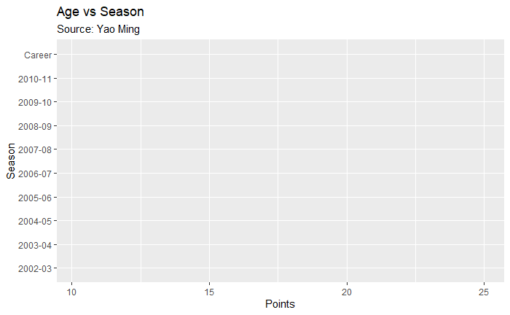
Out of all the season YAO played How many seasons and how many points was he more efficient for the team

Slide 7
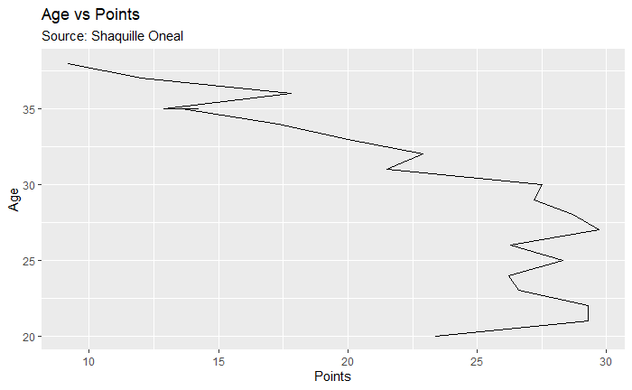
What was Shaqs factor of point to age during his NBA Career?

Slide 8
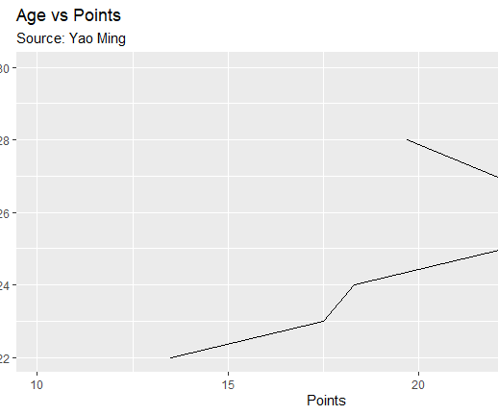
What was yao ming factor of points to age during his NBA Career?

Slide 9
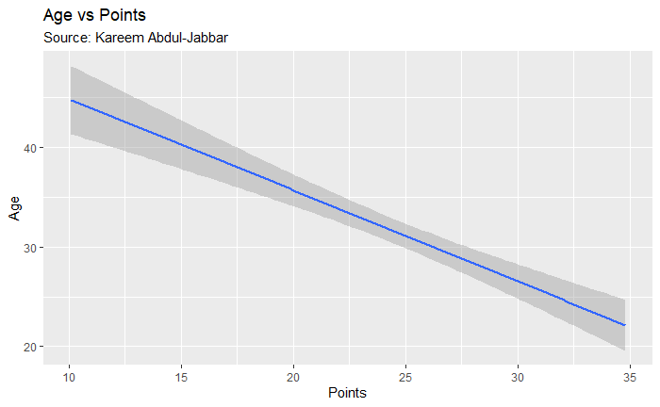
What was Kareem factor in points to age during his NBA Career?

Slide 10
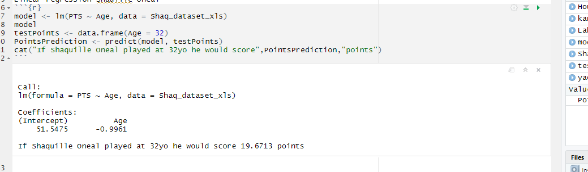
Linear regression model for Shaquille Oneal

Slide 11
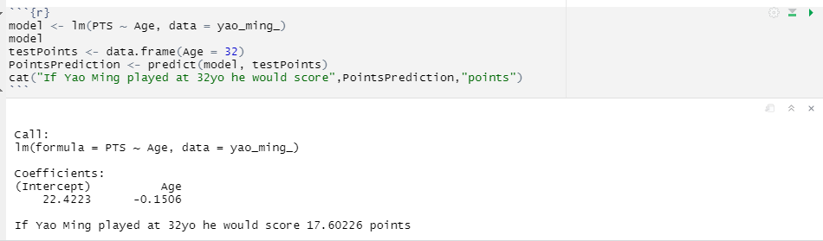
Yao Ming Linear Regression Model

Slide 12
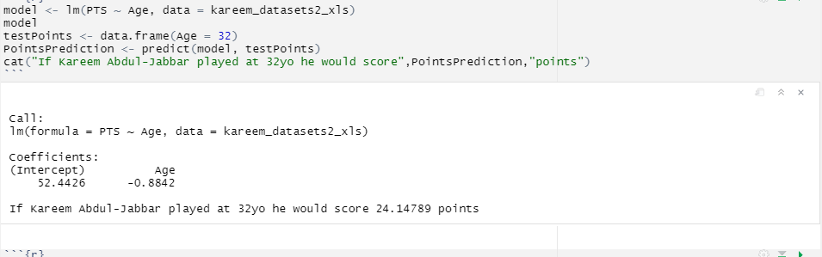
Kareem Abdul- Jabbar Linear Regression Model

Slide 13
Conclusion
In occlusion we have seen from the data analysis that there are two things that Kareem surpasses in points with age than Yao Ming and Shaquille Oneal and that Shaquille Oneal was more sufficient in the Los angeles Lakers , Yao Ming with the Houston rockets , and Kareem Abdul Jabbar with Los angeles Lakers

